Slide 1
Comments
Clean CODE-CHAPTER 4

Slide 2
Comments
Nothing can be quite so helpful as a well-placed comment.
Nothing can be quite so damaging as an old comment that propagates lies and misinformation.
If our programming languages were expressive enough, or if we had the talent to subtly wield those languages to express our intent, we would not need comments very much—perhaps not at all.

Slide 3
Comments Do Not Make Up for Bad Code
Clear and expressive code with few comments is far superior to untidy and complex code with lots of comments.
Rather than spend your time writing the comments that explain the mess you’ve made, spend it cleaning that mess.

Slide 4
Comments Do Not Make Up for Bad Code
//check to see if the employee is eligible for full benefits
If ((employee.scale>bps17 & work.service>18_years) && (employee.age>65))
or this
If (employee.isEligbleForFullBenefits)))

Slide 5
Good Comments
Some comments are necessary or beneficial.
However the only truly good comment is the comment you found a way not to write.

Slide 6
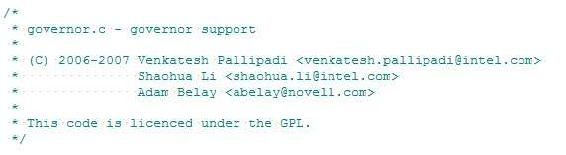
Legal Comments
Sometimes our corporate coding standards force us to write certain comments for legal reasons.
For example, copyright and authorship statements are necessary and reasonable things to put into a comment at the start of each source file.

Slide 7
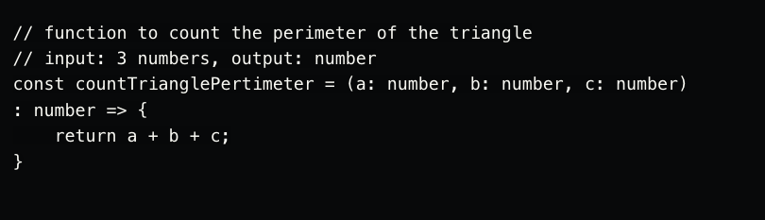
Informative Comments
It is sometimes useful to provide basic information with a comment.

Slide 8
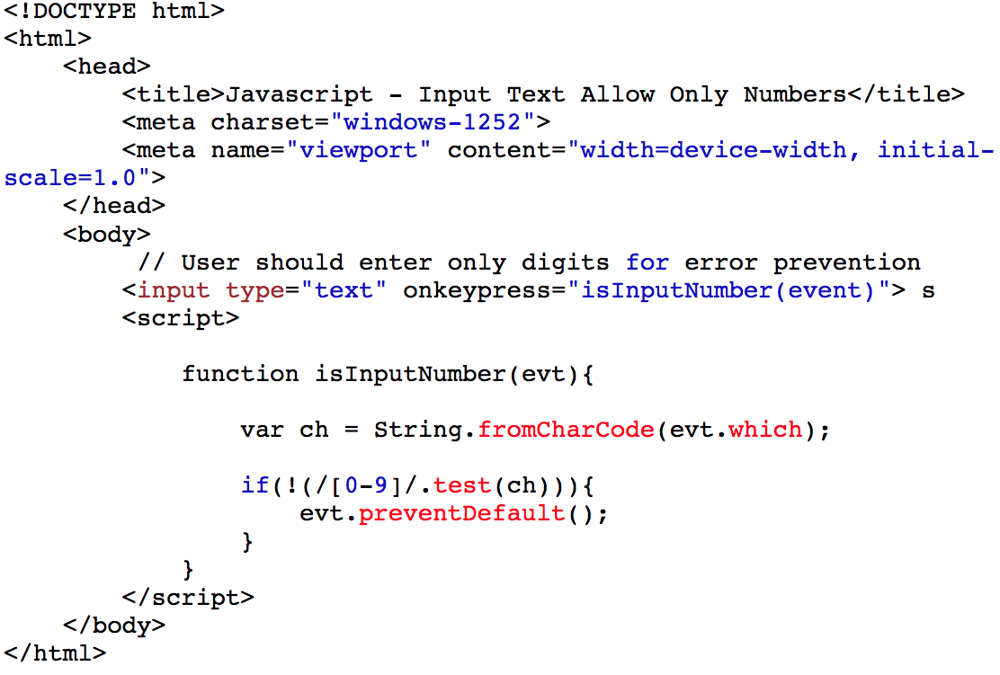
Explanation of Intent
Sometimes a comment goes beyond just useful information about the implementation and provides the intent behind a decision.

Slide 9
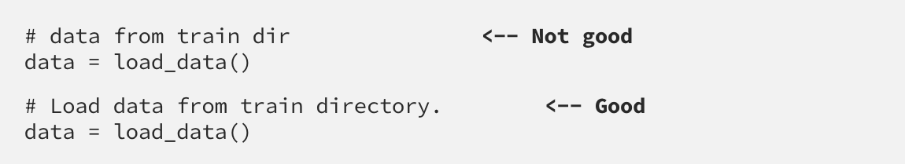
Clarification
Sometimes it is just helpful to translate the meaning of some obscure argument or return value into something that's readable.
Notes:
obscure = not clearly expressed or easily understood.

Slide 10
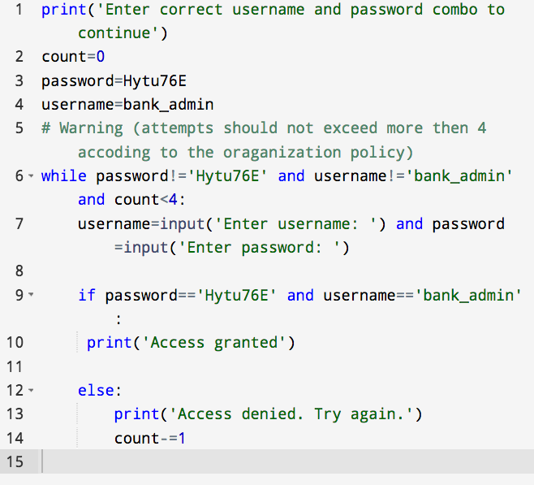
Warning
Sometimes it is useful to warn other programmers about certain consequences.

Slide 11
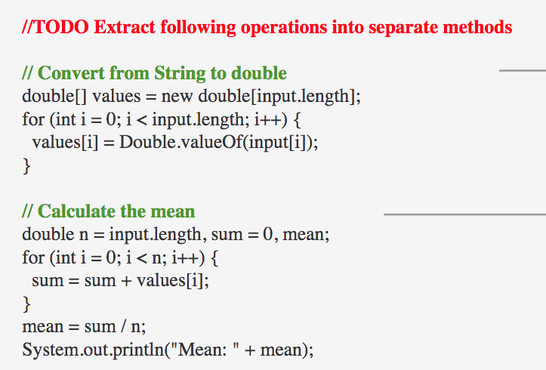
TODO Comments
It is sometimes reasonable to leave “To do” notes in the form of //TODO comments.

Slide 12
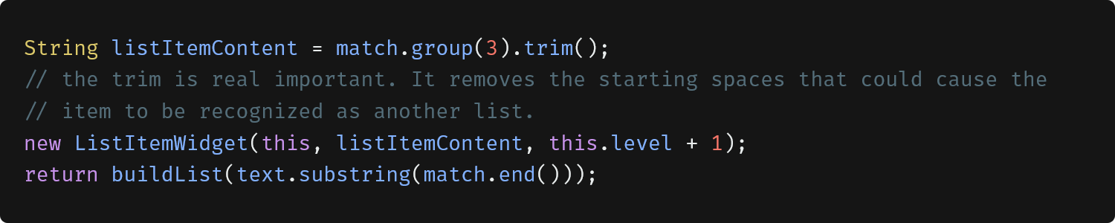
Amplification
A comment may be used to amplify the importance of something that may otherwise seem not important.
Notes:
The trim() method removes whitespace from both sides of a string. The trim() method does not change the original string

Slide 13
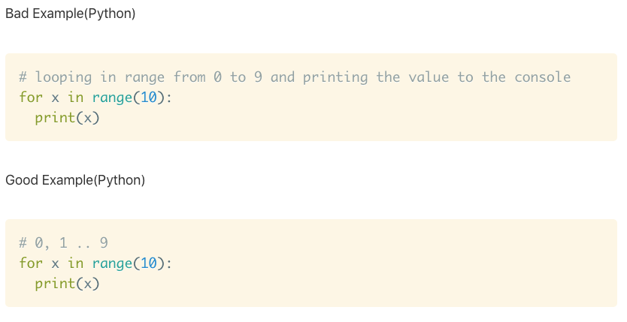
Bad Comments
Most comments fall into this category. Usually they are crutches or excuses for poor code or justifications for insufficient decisions.

Slide 14
Mumbling
Comment that means something to the authors but hard incomprehensible for others.
public void loadProperties() {
try {
String propertiesPath = propertiesLocation + "/" + PROPERTIES_FILE;
FileInputStream propertiesStream = new FileInputStream(propertiesPath);
loadedProperties.load(propertiesStream);
}
catch(IOException e) {
// No properties files means all defaults are loaded
}
}

Slide 15

Redundant Comments
What purpose does this comment serve.
It’s certainly not more informative than the code.
It does not justify the code, or provide intent.
It is not easier to read than the code. Indeed, it is less precise than the code.
Notes:
redundant= بے کار=not or no longer needed or useful

